Slide 1
Report Examples

Slide 2
The Educational Opportunity Gap Oversight and Accountability Committee (EOGOAC)
Charge:
The committee is charged by RCW 28A.300.136 to synthesize the findings and recommendations from the five 2008 Achievement Gap Studies into an implementation plan and recommend policies and strategies to the Superintendent of Public Instruction, the Professional Educator Standards Board and the State Board of Education in the following areas:
Supporting and facilitating parent and community involvement and outreach.
Enhancing the cultural competency of current and future educators and the cultural relevance of curriculum and instruction.
Expanding pathways and strategies to prepare and recruit diverse teachers and administrators.
Recommending current programs and resources that should be redirected to narrow the gap.
Identifying data elements and systems needed to monitor progress in closing the gap.
Making closing the achievement gap part of the school and school district improvement process.
Exploring innovative school models that have shown success in closing the achievement gap.

Slide 3
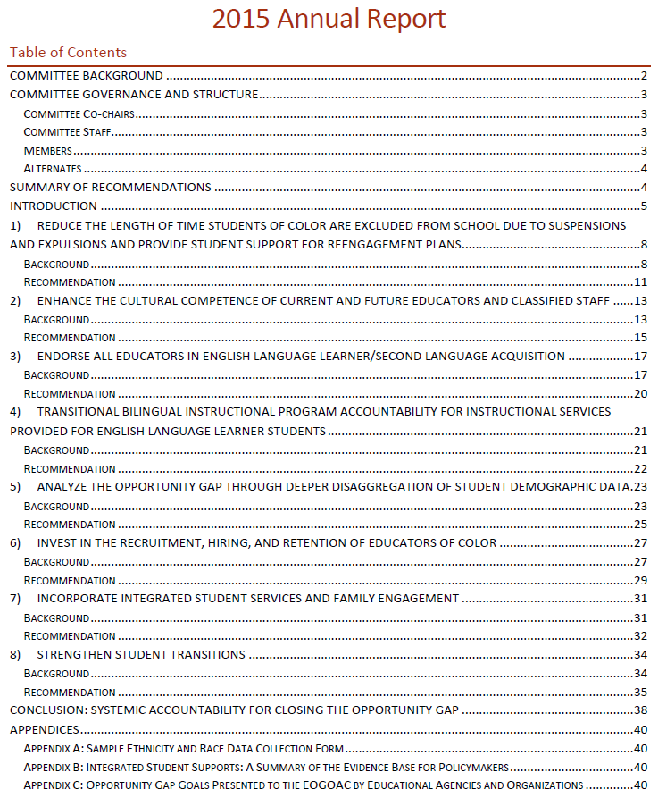
EOGOAC
Report Structure
Committee background
Summary of recommendations
Introduction
Recommendation Topic
Background
Recommendation
Conclusion
Appendices
Report link: http://www.k12.wa.us/Workgroups/EOGOAC/pubdocs/EOGOAC2015AnnualReport.pdf

Slide 4
Student Discipline Task Force (SDTF)
Charge:
In 2013, Engrossed Substitute Senate Bill 5946, Part III (Sec. 301) created RCW 28A.600.490 and charged the Office of Superintendent of Public Instruction to convene a Student Discipline Task Force to develop:
Standard definitions for causes of student disciplinary actions taken at the discretion of the school district.
Data collection standards for disciplinary actions that are discretionary and for disciplinary actions that result in the exclusion of a student from school.
The data collection standards must include:
Information about education services provided while a student is subject to a disciplinary action
The status of petitions for readmission to the school district when a student has been excluded from school
Credit retrieval during a period of exclusion
School dropout as a result of disciplinary action
Notes:
http://www.k12.wa.us/studentdiscipline/pubdocs/StudentDisciplineTaskForceFinalReport2015.PDF

Slide 5
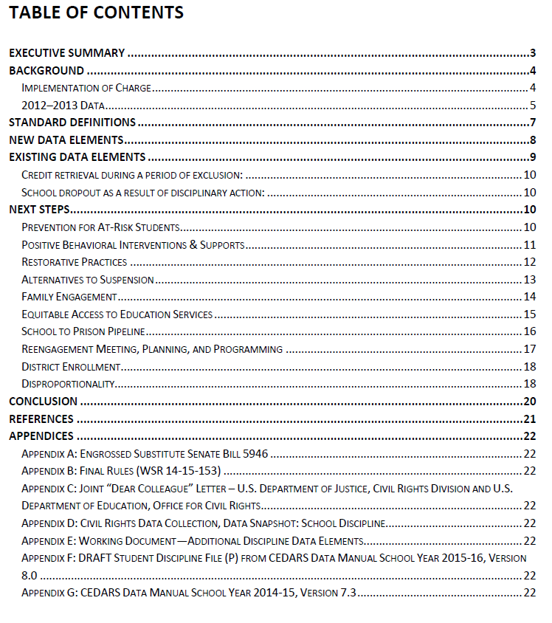
Student Discipline Task Force
Report Structure
Executive summary
Background
Standard definitions
New data elements
Existing data elements
Next Steps
Conclusion
References
Appendices
Report link: http://www.k12.wa.us/studentdiscipline/pubdocs/StudentDisciplineTaskForceFinalReport2015.PDF
Notes:
http://www.k12.wa.us/studentdiscipline/pubdocs/StudentDisciplineTaskForceFinalReport2015.PDF

Slide 6
Compensation Technical Working Group
Charge:
Beginning in July 2011, as outlined in RCW 28A.400.201, the Compensation Working Group began the process of developing an enhanced, collaboratively designed salary allocation model.
The new salary allocation model should align educator development and certification with compensation. It must also:
Attract and retain the highest quality educators
Reduce the number of tiers within the existing salary allocation model
Account for regions of the state where it may be difficult to recruit and retain teachers
Determine the role and types of bonuses available
Provide a solution to accomplish salary equalization over a set number of years
Include cost estimates, including a recognition that staff on the existing salary schedule have an option to be grandfathered permanently to the existing salary schedule
Conduct a comparative labor market analysis of school employee salaries and other compensation
Provide a concurrent implementation schedule

Slide 7
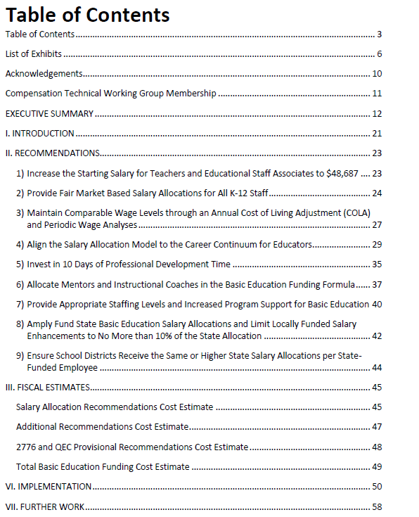
Compensation Technical Working Group
Report Structure
List of exhibits
Acknowledgements
Membership
Executive summary
Introduction
Recommendations
Fiscal Estimates
Implementation
Further work
Appendices
Report link: http://www.k12.wa.us/Compensation/

